Slide 1

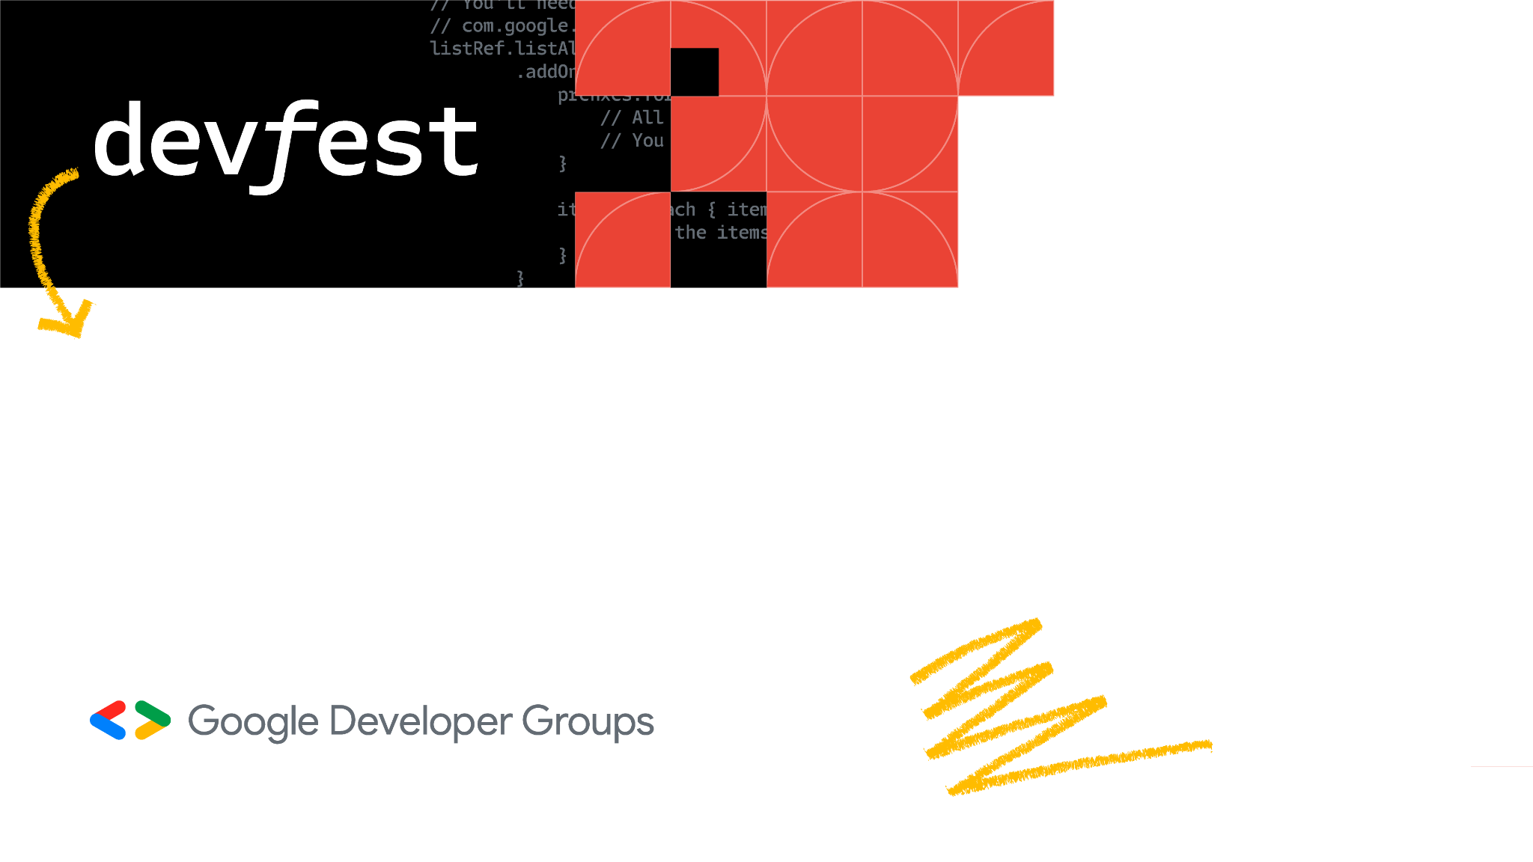

Venturing into the world of Generative AI
Prayagraj

Slide 2
$whoami
Software Engineer at LTIMindtree
Google Developer Expert in Machine Learning
Technical speaker; 30+ talks across India and South East Asia
Contributor to Google Dev Library
Love writing blogs on AI/ML

Slide 3
Contents
What is Generative AI?
Large Language Models
Gemini
Google AI Studio
Some interesting examples
Resources

Slide 4
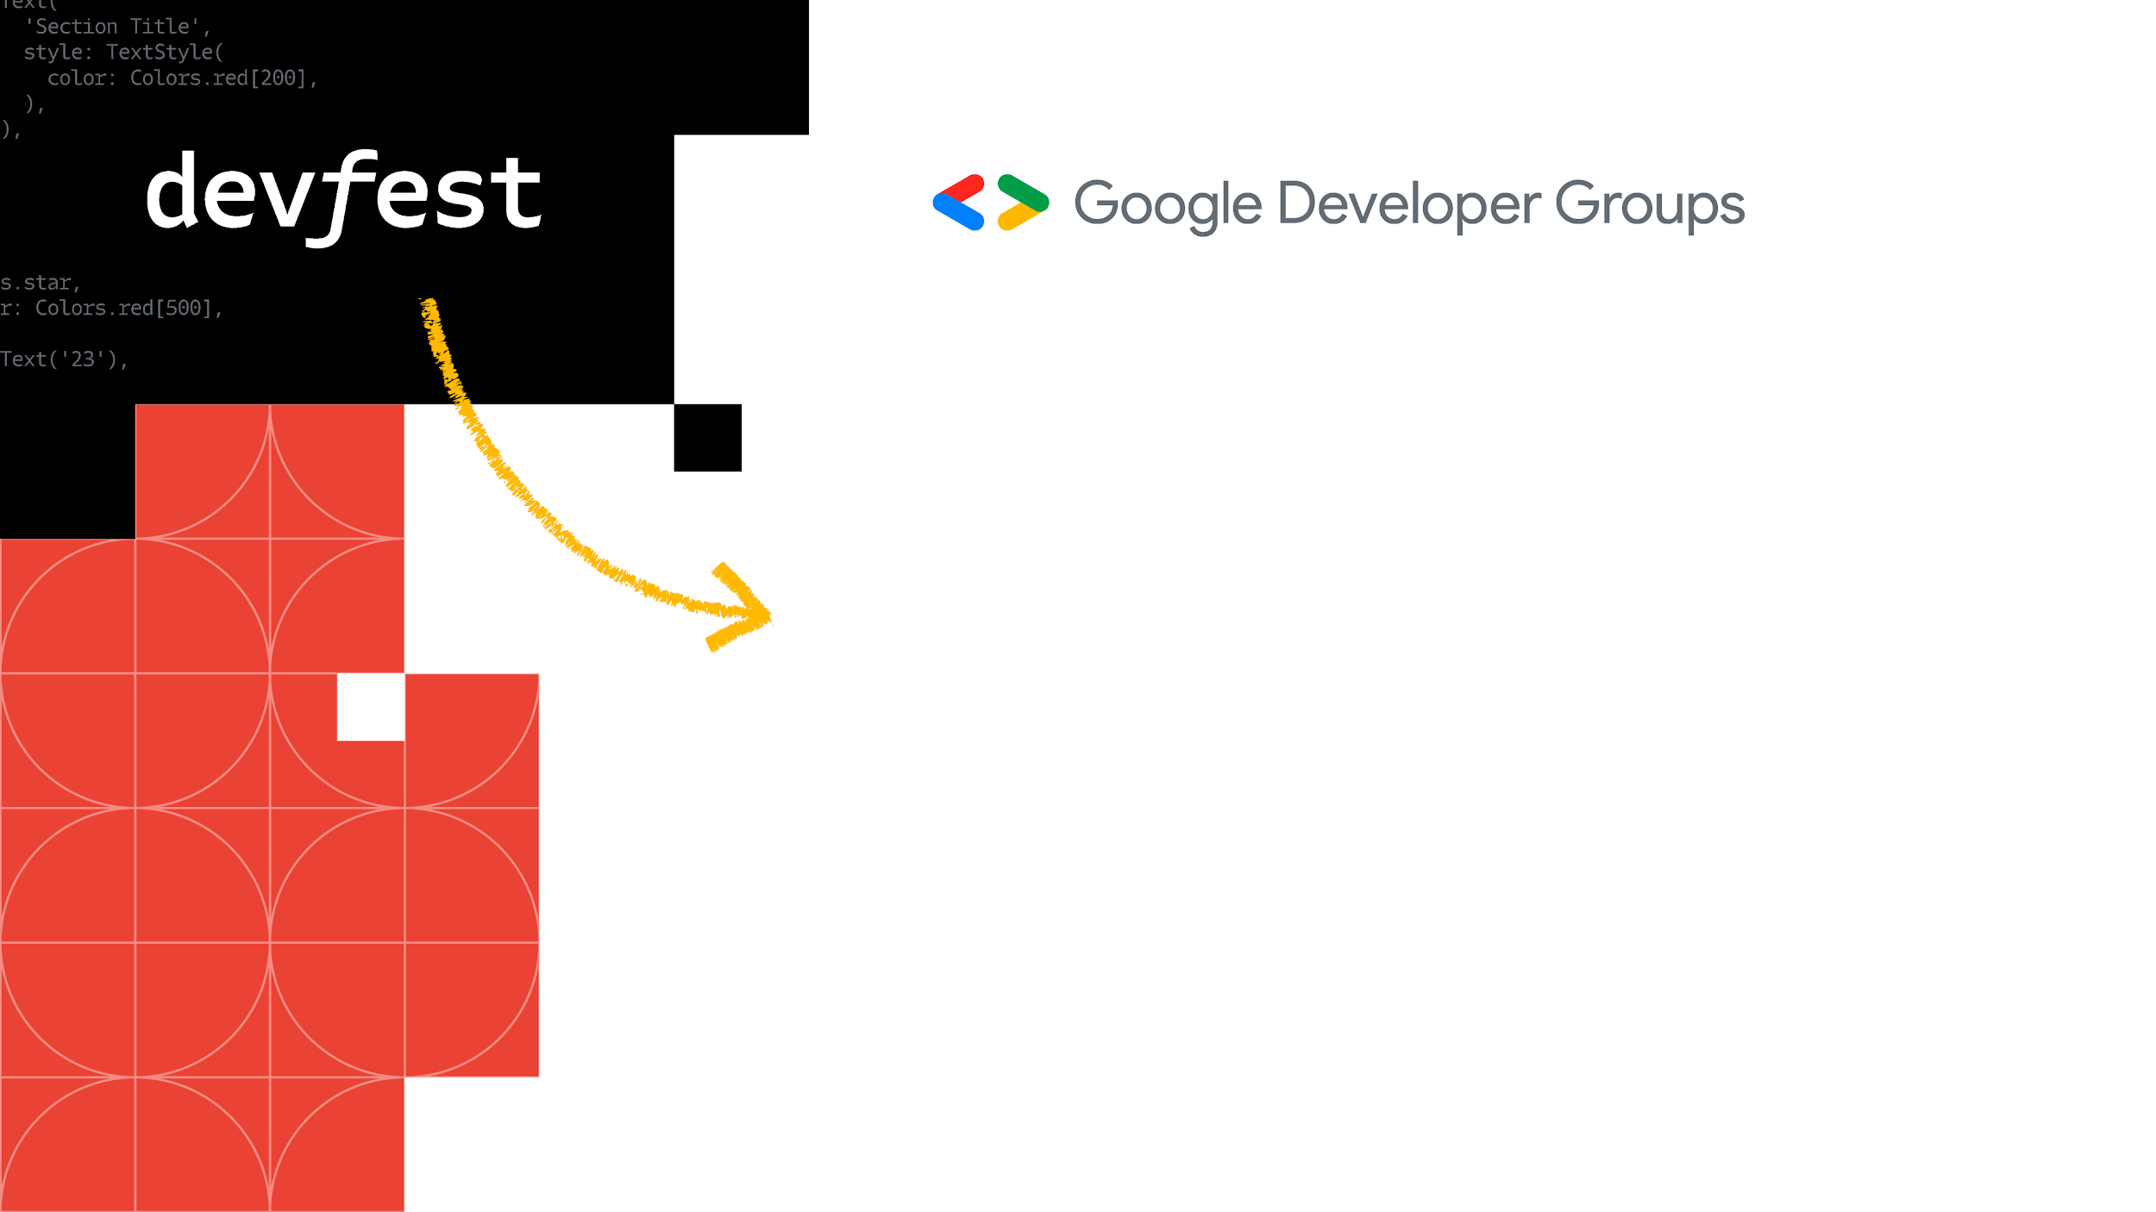
What is Generative AI?
Prayagraj

Slide 5
What is Generative AI?
Generative AI is a type of artificial intelligence (AI) that can create new content, such as text, images, audio, and videos.
It does this by learning from existing data and then using this knowledge to generate new outputs that are similar to the data it has seen.
GenAI Model
Input
Learns patterns in unstructured content
Output
New content
Unstructured content (image, audio, text, video, etc.)

Slide 6
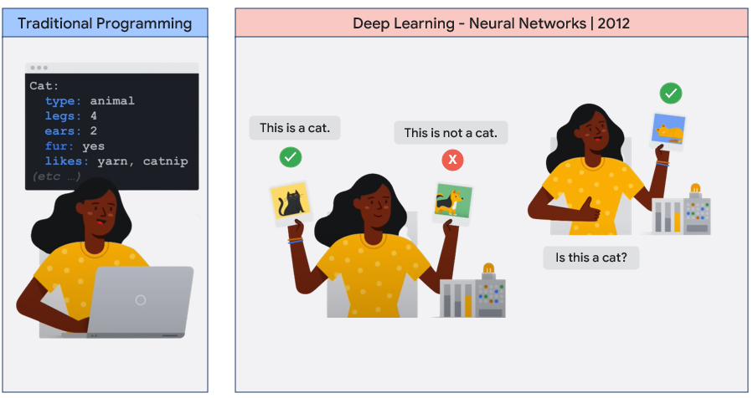

Slide 7
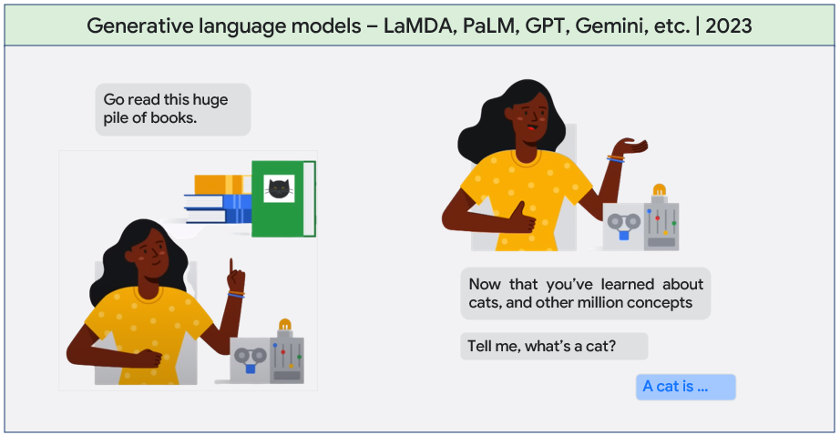

Slide 8


Activity
Step 1: Scan the following QR code.
Step 2: Give a text prompt and try it yourself.
E.g. A cool lion with sunglasses driving a roofless car in space.
Step 3: Take a screenshot of the results.
Step 4: Share it on Twitter (X) with the hashtags #DevFestPrayagraj2023 #GenerativeAI and mention @NSTiwari21 @googledevs @GoogleDevsIN

Slide 9
Large Language Models
Prayagraj

Slide 10
Large Language Models
Large Language Models (LLMs) are large, general-purpose language models that can be pre-trained and then fine-tuned for specific use cases.
Large: Trained on a large training dataset, a large no. of parameters (in billions).
Billions
General purpose: A single model can do multiple tasks.
Text Classification
Question Answering
Document Summarization
Text Generation
Pre-trained and fine-tuned: Pre-train on a large general-purpose dataset and fine-tune to solve specific problems
Healthcare
Retail
Finance
Entertainment

Slide 11
How do these work?
The PaLM and Gemini models are based on the architecture of Transformers.
कइसन बानी प्रयागराज?
Input sequence
Transformers
Encoder
Decoder
Output
How are you Prayagraj?

Slide 12
Kinds of LLM
Generic Language Models: Predict the next work in the text.
The cat sat on ___
[the, a, it, … ]
Instruction: Classify the below text as positive, negative, or neutral.
Instruction-Tuned Models: Trained to predict the response based on given instructions.
Input: I’m enjoying DevFest Prayagraj 2023.
Output: Positive
[User]: What are some best places to visit in Prayagraj?
[Bard]: Triveni Sangam, Akshayavat, Mankameshwar Temple
[User]: How far is the United Institute of Technology from Prayagraj Airport?
[Bard]: The United Institute of Technology is located 27.1 km away from Prayagraj Airport.
Dialog-Tuned Models: Specifically trained on dialogue/conversational data.

Slide 13
Common terminologies in GenAI
Tuning:
The process of adapting a model to a new domain by training on a new custom dataset.
Fine-tuning:
Retrain the foundation model entirely on every weight in the LLM with your own dataset. Can be costly as it requires a big training job.
Parameter-efficient Tuning:
Retrain the model only on certain add-on layers, and not the entire foundation model. Less costly and more viable.
Prompt Design:
The process of creating a prompt (input text) for the LLM so that it can generate outputs.
Model Hallucination:
When LLMs produce wrong/false, improper outputs, they are said to hallucinate.

Slide 14
Gemini
Prayagraj

Slide 15
Gemini
Gemini is the largest, multi-modal AI model developed by Google DeepMind.
Gemini is available in three different sizes – Gemini Ultra, Gemini Pro, and Gemini Nano.
Gemini Ultra
The largest and most capable model for highly complex tasks (coming soon in 2024).
Gemini Pro
The best performing model with features for a wide variety of tasks. Available in Vertex AI, Google AI Studio.
Gemini Nano
The most efficient model for on-device GenAI applications (coming soon in 2024).

Slide 16
Gemini API
Gemini Pro: Optimized for text prompts.
Gemini Pro Vision: Optimized for text and image prompts.
# Install SDK pip install -q -U google-generativeai
import google.generativeai as genai
# Configure API Key
genai.configure(api_key=<your-API-key>)
# Configure the model
model = genai.GenerativeModel('gemini-pro-vision’)
# Give the input image and prompt, get response.
img = PIL.Image.open('image.jpg')
response = model.generate_content([“Describe the image", img], stream=True)

Slide 17
Google AI Studio
Prayagraj

Slide 18
Google AI Studio
Google AI Studio, formerly known as MakerSuite, is a browser-based IDE for prototyping with generative models. https://makersuite.google.com
Google AI Studio lets you quickly try out models and experiment with different prompts.
The prompts created can be easily exported to codes in your preferred programming language, powered by the Gemini API.
For a complete walkthrough of Google AI Studio, visit the following link: https://ai.google.dev/tutorials/ai-studio_quickstart

Slide 19
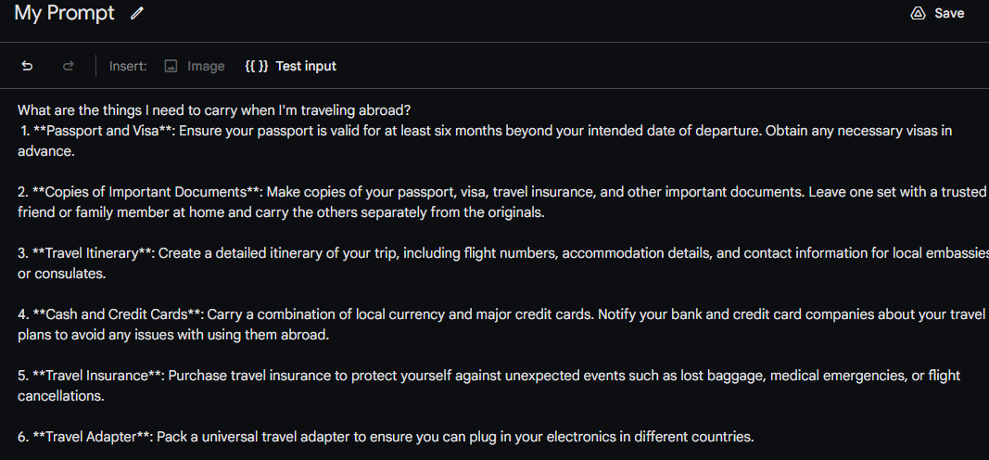
Try out an example – Gemini Pro
Prompt: What are the things I need to carry when I’m traveling abroad?

Slide 20
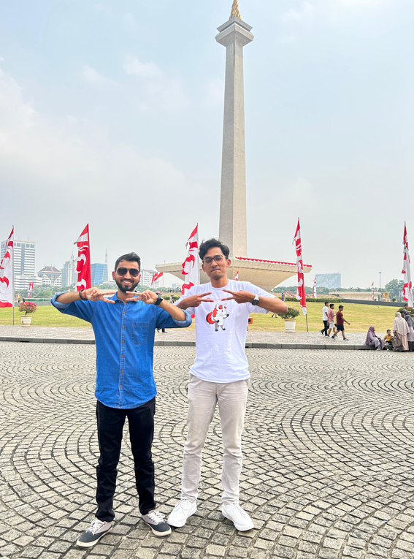
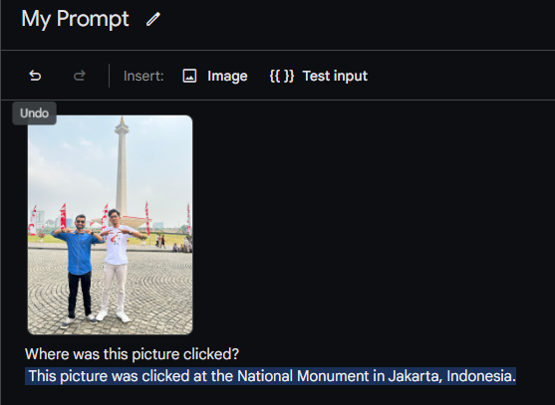
Try out an example – Gemini Pro Vision
Image Prompt: *Image of me at the National Monument, Jakarta.*
Text Prompt: Where was this picture clicked?

Slide 21
Possibilities with ML

Slide 22
Some interesting examples
Prayagraj

Slide 23
PharmaScan: An Android app to get medicine details using Gemini Pro Vision

Slide 24
Pose Classifier-based Video Game Controller – Ashes Cricket 2009

Slide 25
Real-time object detection – GTA Vice City

Slide 26
#SolveForEnvironment: Waste Detection on the browser using TF.js-TFLite

Slide 27
How do I get started?

Slide 28
Resources
Prayagraj

Slide 29
Fundamentals
Intermediate
Advanced
Machine Learning Specialization by DeepLearning.AI https://www.coursera.org/specializations/machine-learning-introduction
Generative AI Learning Path by Google https://www.cloudskillsboost.google/journeys/118
Deep Learning Specialization by DeepLearning.AI https://www.coursera.org/specializations/deep-learning
Computer Vision Fundamentals with Google Cloud https://www.coursera.org/learn/image-understanding-tensorflow-gcp
Official TensorFlow website https://www.tensorflow.org
Official Keras website https://www.keras.io
DeepLearning.AI TensorFlow Developer Professional Certificate https://www.coursera.org/professional-certificates/tensorflow-in-practice
TensorFlow: Data and Deployment Specialization https://www.coursera.org/specializations/tensorflow-data-and-deployment
Generative Adversarial Networks (GANs) Specialization https://www.coursera.org/specializations/generative-adversarial-networks-gans
Natural Language Processing Specialization https://www.coursera.org/specializations/natural-language-processing
MediaPipe Solutions https://developers.google.com/mediapipe
Kaggle Models https://www.kaggle.com/models
Machine Learning Engineering for Production (MLOps) https://www.coursera.org/specializations/machine-learning-engineering-for-production-mlops
Vertex AI – Google Cloud https://cloud.google.com/vertex-ai
Advanced Machine Learning on Google Cloud https://www.coursera.org/specializations/advanced-machine-learning-tensorflow-gcp
Production Machine Learning Systems https://www.coursera.org/learn/gcp-production-ml-systems
TensorFlow: Advanced Techniques Specialization https://www.coursera.org/specializations/tensorflow-advanced-techniques
Notes:
Audience split: 20% community, 55% devs, 25% partners
(expecting heavy overlap between comm and dev)

Slide 30
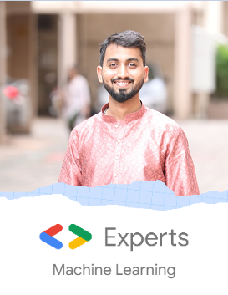




Thank You.
github.com/NSTiwari
medium.com/@tiwarinitin1999
twitter.com/@NSTiwari21

